Slide 1
Data Structures and Algorithms
Lecture 1:
Course Introduction
Department of Computer Science & Technology
United International College

Slide 2
Course Information –1001/1004
Teaching Staff
  Instructor: Jianxiong Guo
    Office: T3-501-R8
    Email: jianxiongguo@uic.edu.cn
  TA: Yandi Li
    Office: TBA
    Email: liyandi@uic.edu.cn
  TA: Xubin Wang
    Office: TBA
    Email: wangxubin@uic.edu.cn

Slide 3
Course Information –1003/1006
Teaching Staff
  Instructor: Amy Hui Zhang
    Office: T3-602-R7
    Email: amyzhang@uic.edu.cn
  TA: Nina Yingran Ma
    Office: TBA
    Email: yingranma@uic.edu.cn
  TA: Yuting Lai
    Office: TBA
    Email: t330201608@mail.uic.edu.cn

Slide 4
Course Information –1005/1009
Teaching Staff
  Instructor: Xiao Dong
    Office: T6-403-R2
    Email: jianxiongguo@uic.edu.cn
  TA: Yinong Xu
    Office: TBA
    Email: morrisynxu@uic.edu.cn
  TA: Ziting Xu
    Office: TBA
    Email: xuziting@uic.edu.cn

Slide 5
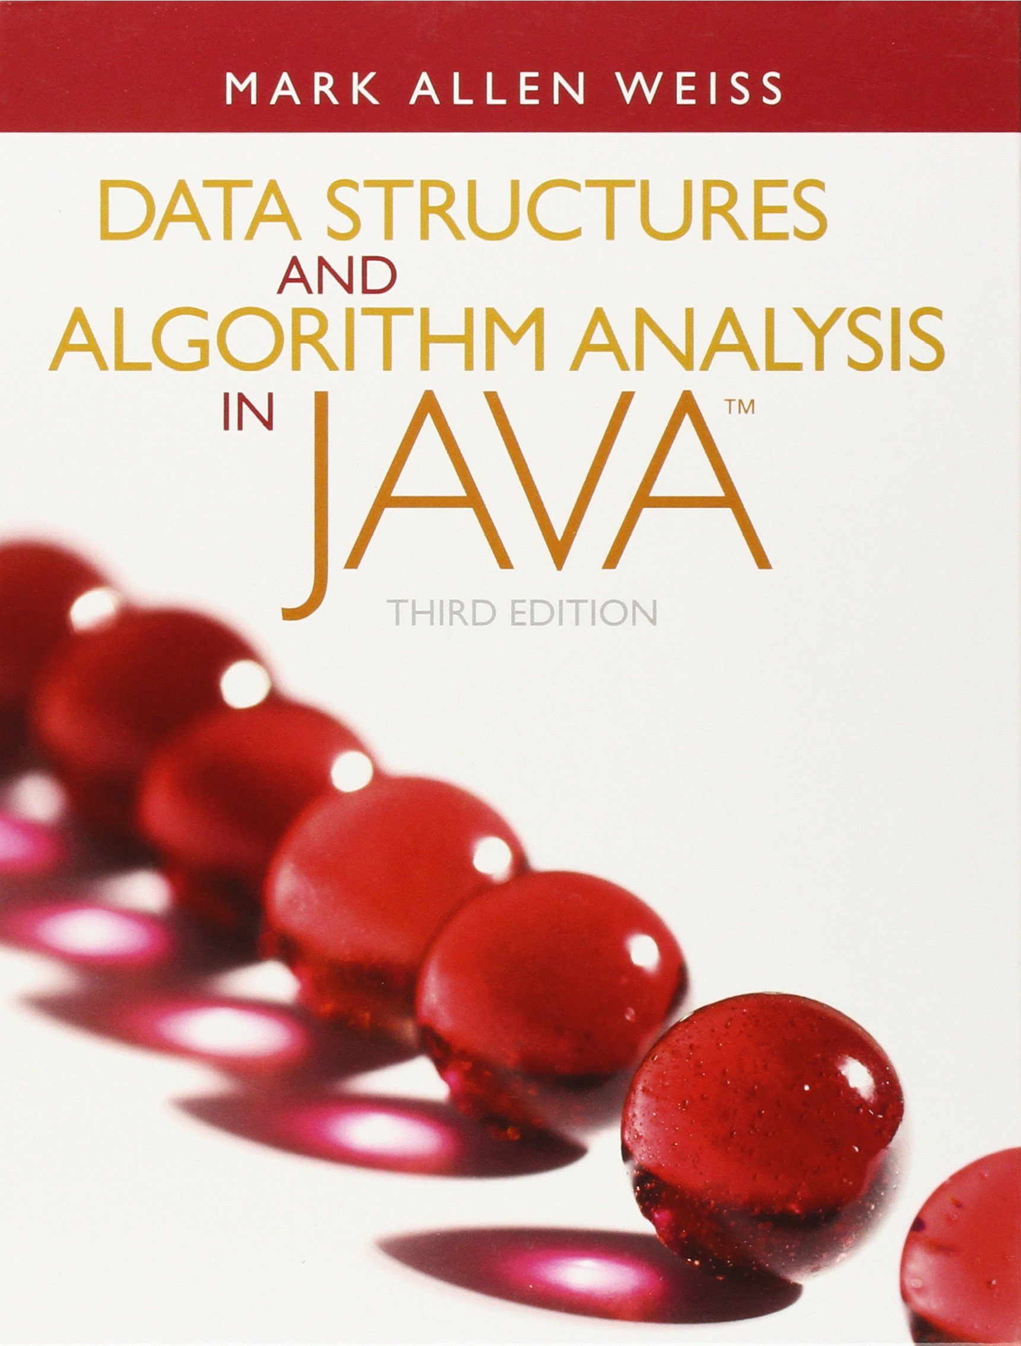
Textbook
Any version is fine

Slide 6
Grading
Assignments
  Written assignments (15%)
  Coding assignments (35%)
Quizzes / Midterm Examination (10%)
Final Examination (40%)

Slide 7
Late Submissions
No late submission is accepted.
  Sufficient time will be given for every assignment.
  Failing to submit your works on time will result in a score of zero.
  Mind the deadlines!

Slide 8
Plagiarism Policy
Assignments: both get 0
  Regardless of who copied who
  Be protective of your works!
Exams: an automatic FAIL
You are not allowed to copy or slightly change others’ solutions or codes. You are not allowed to copy from the Internet either. All the works you submit must be your own.

Slide 9
Course Overview
A fundamental computer science course
  Essential for programming
  Essential for advanced courses
A challenging course, which needs
  Mathematical and logical thinking
  Programming

Slide 10
Course Prerequisite
Programming
  Need to know Java
  Eclipse or other PC programming environment
  Good programming skills
  Translate pseudo-codes into codes
Basic mathematical skills
  Solving recursive equations, manipulation of symbols, etc.
Computer architecture
  Storage, memory access, etc.

Slide 11
Topics Covered in this Course
Algorithm Analysis
  Mathematical Background, Big-O, Running time Calculation
Abstract Data Types
  Lists, Stacks, and Queues
Sorting
  Insertion Sort, Merge Sort, Quick Sort
  Heaps and Heap Sort
Trees
  Tree Traversals, Binary Trees and Binary Search Trees, AVL Trees, and B+ Trees
Graph Algorithms
  Breadth First Search

Slide 12
Overall Goal of the Course
From programmer to architect
Learn to solve problems
Algorithms and programming go hand in hand
Learn to analyze your solutions

